Slide 1
Structural Competency Training

Slide 2
Module 3: Imagining and Implementing Structural Interventions

Slide 3
Learning Objectives
To describe at least one historical or contemporary example of an intervention that addressed structural violence and vulnerability.
To define and understand six levels of intervention for addressing harmful social structures.
To identify a challenge and a strategy for at least one of the six levels of intervention that is applicable in a provider setting.
To define “Beloved Community” and articulate its importance for structurally competent practice.
To identify at least one intervention strategy to implement to address structural causes of ill health.

Slide 4
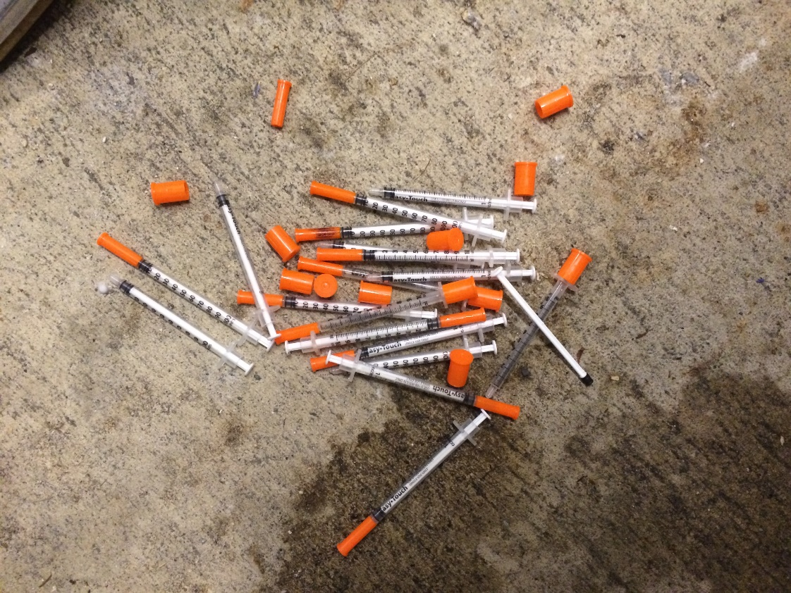
The Integrated Soft Tissue Infection Service Clinic
“They prioritized pain management and recruited experienced clinicians committed to what they called ‘compassionate’ healthcare for injection drug-users.”
– Messac et al.
SOURCE: Messac L. et al. “The good-enough science-and-politics of anthropological collaboration with evidence-based clinical research: Four Ethnographic Case Studies.” Social Science and Medicine. 2013.
Notes:
The first example we want to share is local. It’s about the creation of a special clinic in the SF DPH.
In the early 2000s, two anthropologists doing fieldwork with homeless people using injection drugs in SF. They learned that when injection drug users came to the county hospital for abscess treatment, their abscesses were often cut into without any anesthesia and they were not offered pain medications for after care.
Residents who performed these procedures were exhausted and frustrated by seeing patients cycle back again and again for injuries they primarily saw as self-inflicted. As a result, patients began to lance their own abscesses in unsterile conditions and became more sick.
One of the anthropologists was also a doctor, and he began to provide urgent care and minimally invasive abscess drainage in the encampments. He worked together with surgeons and residents to determine that abscess drainage was their single largest admission category, and to create a service that would train residents and specialize in providing better care to these patients. After surgeons at the county implemented the new procedure, ER visits to the county hospital fell by almost 34%.
The surgeons eventually presented their minimally invasive incision-and-drain outpatient procedure with emphasis on analgesics as an evidence- based best-clinical practice, aiming to establish a national standard of care.
((Structures: things leading to drug use, homelessness, hyper-incarceration, War on Drugs, lack of funding for stigmatized issues etc.
How did structural competency help to bring this about? All the things the doctor did This kind of reflection, investigation and advocacy is within our reach as health care providers! ))
SOURCE: Messac L. et al. “The good-enough science-and-politics of anthropological collaboration with evidence-based clinical research: Four Ethnographic Case Studies.” Social Science and Medicine. 2013.
Image of injection drug use by Cat Branchman, retrieved from: https://www.flickr.com/photos/kozemchuk/38308481332/in/photolist-21nbYRs-opKQjE-dCw7ii-619tGG-9zZDMo-8fELGV-Zj5qjo-2duuyWx-L68gjf-obZwcN-6agQbp-q27rVB-etTAL4-JmF1mA-cAMVVU-dqG1DP-cAMX9j-S6q1Ap-9mtvXU-ihh6xf-5Ymed5-XoW6ae-WpCQzp-7JnnnQ-5DCB5v-2fvqC4-A8zQK-jeJgR8-4wEMp4-k3iA6-oJh1PN-269v736-osVqvK-2d9kpD2-4JWYZE-V2Rbx1-CJj3-fF4kYW-9ZNSB-8jhNsQ-s5sZKT-UEQkFj-2vAhV2-9mjzbt-dqGav1-soN986-q1ZXem-jNjxR-cb6ych-axRrxW on 5/212/19. Creative Commons License associated: CC BY 2.0

Slide 5
Black Panther Survival Programs Health Clinics (Berkeley Free Clinic, West Oakland Health Center) Breakfast Programs Food Giveaways Legal Clinics Free Busing to prisons for families Sickle Cell Testing
SOURCE: Nelson, Alondra. Body and Soul: The Black Panther Party and the Fight against Medical Discrimination. Minnesota: U of Minnesota, 2011.
Image by Library of Congress, retrieved from: https://picryl.com/media/you-can-jail-a-revolutionary-but-you-cant-jail-the-revolution-1 on 1/23/19. Image is in the public domain.
Notes:
In the mid-1960s, Americans were widely coming to recognize how tremendous inequality, racism and economic and social oppression was harming the health of African American children and adults.
The Black Panther Party in the 1960s mandated that each of its chapters create a People’s Free Health Clinic as a response to these structurally-rooted health inequities, and to specifically address lack of access to medical care and abuse of blacks by medical systems (through, for example, unethical experimentation on blacks).
These “no-cost” clinics accomplished a great deal, offering basic health care services like immunizations, screenings for TB, lead poisoning, SCD and more. They drew upon the WHO’s inclusive definition of health and provided legal aid, housing assistance, and meals for children as well as health care.
The clinics were staffed by party members and health professional volunteers including medical students. Many of the volunteers came from more privileged backgrounds, and so as they volunteered, they were required to attend classes where they read and discussed important post-colonial writings to build solidarity between these medical professionals and the community coming to these clinics. These volunteers treated patients while also training party members as physicians’ assistants.
—clinic; intrapersonal; interpersonal; policy (of a party)
SOURCE: Nelson, Alondra. Body and Soul: The Black Panther Party and the Fight against Medical Discrimination. Minnesota: U of Minnesota, 2011.
Image by Library of Congress, retrieved from: https://picryl.com/media/you-can-jail-a-revolutionary-but-you-cant-jail-the-revolution-1 on 1/23/19. Image is in the public domain.

Slide 6
Levels of Intervention
Individual
Interpersonal
Clinic
Community
Research
Policy

Slide 7
In Emergency Department After Found on Street
Begins Drinking More Heavily
Gets Assaulted
Can’t Pay Rent, Moves to Street
Injury, Can’t Work
Begins Working as Day Laborer
Moves to San Francisco
Influx of Cheap U.S. Corn
4th Generation Corn Farmer in Oaxaca
Educate yourself and work against implicit and explicit racism and other bias
Approach the patient without blame or judgment
Use an interpreter; diversify staff; provide structural competency training for all staff
Advocate for safe spaces and affordable housing for community members
Research the structural forces that affect the lives and health of migrants who work as day laborers, including policy and racism in your research questions and discussion
Advocate for more just housing policy;
Organize against trade agreements that contribute to the exploitation of foreign labor;
Organize for universal healthcare
Individual
Interpersonal
Clinic
Community
Research
Policy

Slide 8
Group Exercise
Work in groups of 2 to 4. Brainstorm approaches at various levels to prevent and/or address the illness and injury experienced by this patient.
Include at least one approach that you feel is quite feasible – something concrete that could be done immediately (potentially with support from the right people)
Include at least one approach that is big-picture, bold, ambitious – something that you would do if you had a “magic wand” to address structural issues. Use your structural imagination! Don’t constrain yourself to interventions that seem “practical” in the short term.
“It always seems impossible until it’s done.” -Nelson Mandela

Slide 9
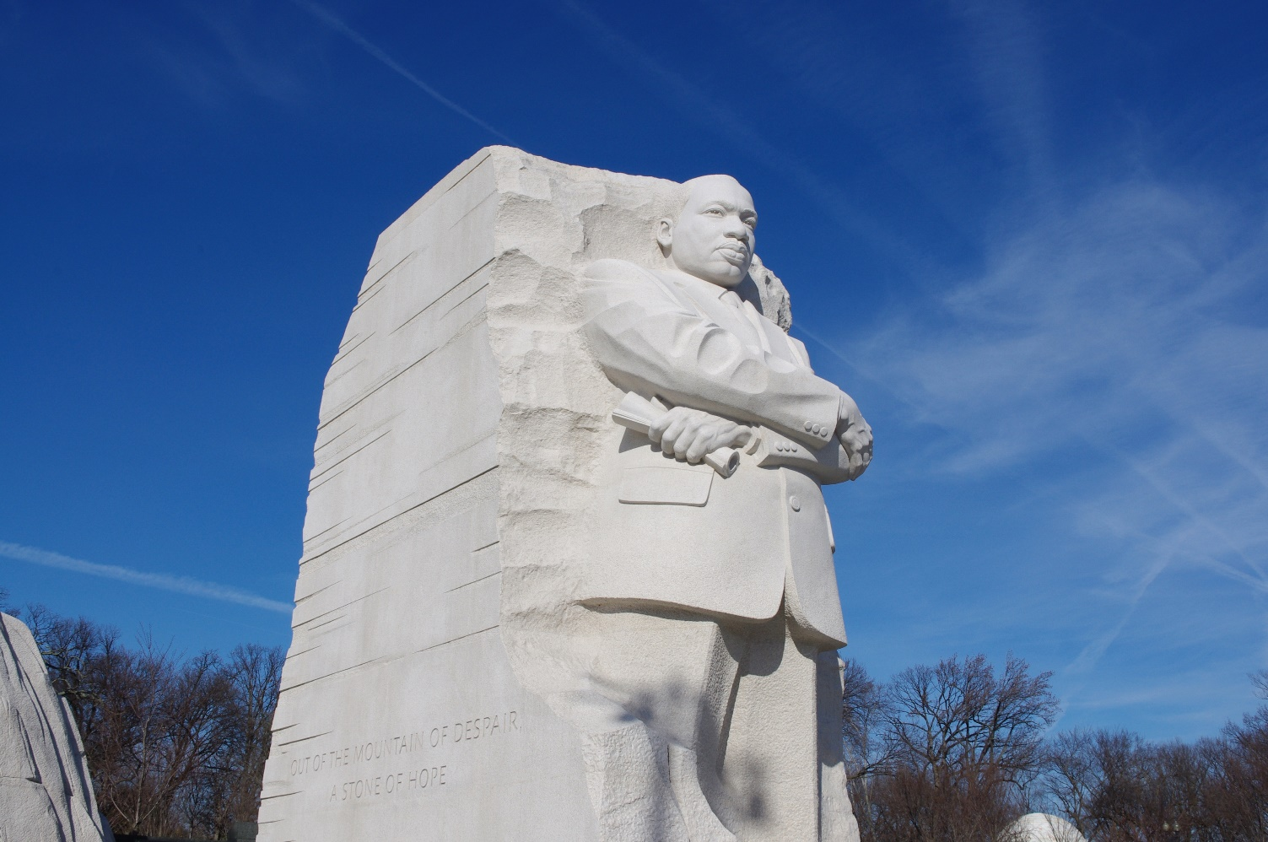
Building Beloved Community In Our Life and Work
Image by Michael Saffle, retrieved from https://www.flickr.com/photos/nonoboy/6639037175/in/photolist-SRPsMu-Sd1R1b-6i5pFU-oepbFi-oeikkx-b7EN8V-8v5Jfr-Eiy84z-xM7czx-b7ENsc on 5/12/19. Image is in the public domain.
Notes:
Image by Michael Saffle, retrieved from https://www.flickr.com/photos/nonoboy/6639037175/in/photolist-SRPsMu-Sd1R1b-6i5pFU-oepbFi-oeikkx-b7EN8V-8v5Jfr-Eiy84z-xM7czx-b7ENsc on 5/12/19. Image is in the public domain.

Slide 10
Working Definition of Beloved Community
An inclusive, interconnected consciousness
based on love, justice, compassion, responsibility, shared power, and
a deep respect for all people, places, and things
that radically transforms individuals and restructures institutions.
Shirley Strong, Chief Diversity Officer, Samuel Merritt University
Notes:
Beloved community
Burn out
Structures: don’t have to do it (in fact you can’t!) alone

Slide 11
“Every proposed reform, every moral deed, is to be tested by whether and to what extent it contributes to the realization of the Beloved Community”
“ When one cannot find the Beloved Community we need to take steps to create it and if there is no evidence of its existence then the rule to live by is to:
—Act so as to hasten its coming”
Josiah Royce (1855-1916)
Boston University School of Theology
Image by The Royce Society, retrieved from: https://commons.wikimedia.org/wiki/File:Josiah_Royce.jpeg on 12/16/18. Image is in the public domain.
Notes:
Image by The Royce Society, retrieved from: https://commons.wikimedia.org/wiki/File:Josiah_Royce.jpeg on 12/16/18. Image is in the public domain.

Slide 12
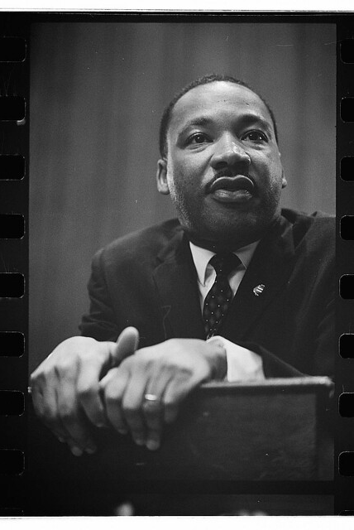
Martin Luther King, Jr.
Dr. King’s beloved community, rather than something we reach some day in the future, may be something we experience a little bit every day, while we work towards it.
The aftermath of nonviolence is the creation of reconciliation and beloved community, while the aftermath of violence is tragic bitterness.
True compassion [Beloved Community] is more than flinging a coin to a beggar. It comes to see that an edifice that produces beggars needs restructuring.
Image by The Library of Congress, retrieved from: https://www.flickr.com/photos/library_of_congress/15172974650/in/photolist-p7MsKd-edWUc3-aJcrZ2-odf59f-bewU7x-edEMdY-aJctCz-aJcfux-2feLSkQ-2feLSiL-9kjMEw-buYYFe-aJcwyB-aJcpMg-2feLSpY-jhwcbv-2f19Vbu-bewUCk-2dVz87r-SRPsMu-mwuUuB-dMaW4K-dMaW5Z-9beYYP-Sd1R97-bewh2P-23pHSTV-bewrH8-bewycK-8LTnQf-bewMjx-qPkV3j-bewUKv-bewHCx-bexbit-bewVi8-euMR4w-bewNqc-9fpZph-9bi7tN-2egx7iy-Fstn6y-avzaEk-S5PRos-eZnbZB-9fpZpw-22dSmbH-avzmKt-avzb3p-FstUsb on 5/12/19. No known copyright restrictions.
Notes:
Image by The Library of Congress, retrieved from: https://www.flickr.com/photos/library_of_congress/15172974650/in/photolist-p7MsKd-edWUc3-aJcrZ2-odf59f-bewU7x-edEMdY-aJctCz-aJcfux-2feLSkQ-2feLSiL-9kjMEw-buYYFe-aJcwyB-aJcpMg-2feLSpY-jhwcbv-2f19Vbu-bewUCk-2dVz87r-SRPsMu-mwuUuB-dMaW4K-dMaW5Z-9beYYP-Sd1R97-bewh2P-23pHSTV-bewrH8-bewycK-8LTnQf-bewMjx-qPkV3j-bewUKv-bewHCx-bexbit-bewVi8-euMR4w-bewNqc-9fpZph-9bi7tN-2egx7iy-Fstn6y-avzaEk-S5PRos-eZnbZB-9fpZpw-22dSmbH-avzmKt-avzb3p-FstUsb on 5/12/19. No known copyright restrictions.

Slide 13
How would things be different?
Image by Marion S. Trikosko, retrieved from: https://commons.wikimedia.org/wiki/File:MLK_and_Malcolm_X_USNWR_cropped.jpg on 12/16/18. Image is in the public domain.
Notes:
Image by Marion S. Trikosko, retrieved from: https://commons.wikimedia.org/wiki/File:MLK_and_Malcolm_X_USNWR_cropped.jpg on 12/16/18. Image is in the public domain.
Grace Lee Boggs asked, “I wonder how things would have been different, both intraracially and interracially, had we been able to combine Malcolm’s militancy with Martin’s Beloved Community?”

Slide 14
Grace Lee Boggs
Image by Kyle McDonald, retrieved from: https://commons.wikimedia.org/wiki/File:Grace_Lee_Boggs_2012.jpg on 12/16/18. Creative Commons License attribution: CC BY 2.0
1915-2015
Notes:
Image by Kyle McDonald, retrieved from: https://commons.wikimedia.org/wiki/File:Grace_Lee_Boggs_2012.jpg on 12/16/18. Creative Commons License attribution: CC BY 2.0
Grace Lee Boggs was a Detroit-based philosopher, civil rights activist, and writer who dedicated her life to the fight for racial justice.

Slide 15
Three principles of action
(1) Improve the conditions of daily life
(2) Tackle the inequitable distribution of power, money, and resources
(3) Measure the problem, evaluate action, expand the knowledge base, develop a workforce trained in SDOH
Marmot, M. et al. (2008). Closing the gap in a generation: health equity through social action on the social determinants of health. Lancet, 372, 1661-1669.

Slide 16
Module 3: Summary of Key Points
Structural frameworks can also inspire structural interventions
Examples of such interventions include The Integrated Soft Tissue Infection Service Clinic and the Black Panther Survival Programs
Interventions can operate at many levels including: individual, interpersonal, clinic, community, research, and policy
Community-building is an important part of this work. Beloved Community is a powerful framework for bringing people together to radically transform our world.

Slide 17
Reflection Exercise
Write down the levels of intervention that you have identified as areas where you can take action.
What are 1-2 specific actions that will you take?
What potential barriers can you identify for taking these action steps?
What will help you to navigate and address these potential barriers?

Slide 18
Wrapping Up
Notes:
Normalizing being distressed vis a vis Santa Rosa.
Clinical people want to fix things and quickly.
Structural problems take time and collective action.

Slide 19
Contact us
www.structcomp.org
structuralcompetency@gmail.com

Slide 20
Post-Training Surveys

